Slide 1

Objectives
In this session, you will learn to:
  Describe the key features of Java technology
  Write, compile, and run a simple Java technology application
  Describe the function of the Java Virtual Machine
  Define garbage collection
  List the three tasks performed by the Java platform that handle code security
  Define modeling concepts: abstraction, encapsulation, and packages
  Discuss why you can reuse Java technology application code
  Define class, member, attribute, method, constructor, and package
  Use the access modifiers private and public as appropriate for the guidelines of encapsulation

Slide 2
Objectives (Contd.)
  Invoke a method on a particular object
  Use the Java technology Application Programming Interface online documentation

Slide 3
Key Features of Java Technology
A programming language
A development environment
An application environment
A deployment environment
Java Technology is used for developing both applets and applications.

Slide 4
Primary Goals of the Java Technology
Provides an easy-to-use language by:
  Avoiding many pitfalls of other languages
  Being object-oriented
  Enables code streamlining
Provides an interpreted environment for:
  Improved speed of development
  Code portability
Loads classes dynamically, i.e., at the time they are actually needed
Supports changing programs dynamically during runtime by loading classes from distinct sources
Furnishes better security
Enable users to run more than one thread of an activity

Slide 5
Primary Features of the Java Technology
The Java Virtual Machine (JVM™)
Garbage collection
The Java Runtime Environment (JRE)
JVM tool interface

Slide 6
The Java Virtual Machine
JVM provides definitions for the:
  Instruction set (Central Processing Unit [CPU])
  Register set
  Class file format
  Runtime stack
  Garbage-collected heap
  Memory area
  Fatal error reporting mechanism
  High-precision timing support

Slide 7
Garbage Collection
Garbage collection has the following characteristics:
  Checks for and frees memory no longer needed, automatically.
  Provides a system-level thread to track memory allocation.

Slide 8
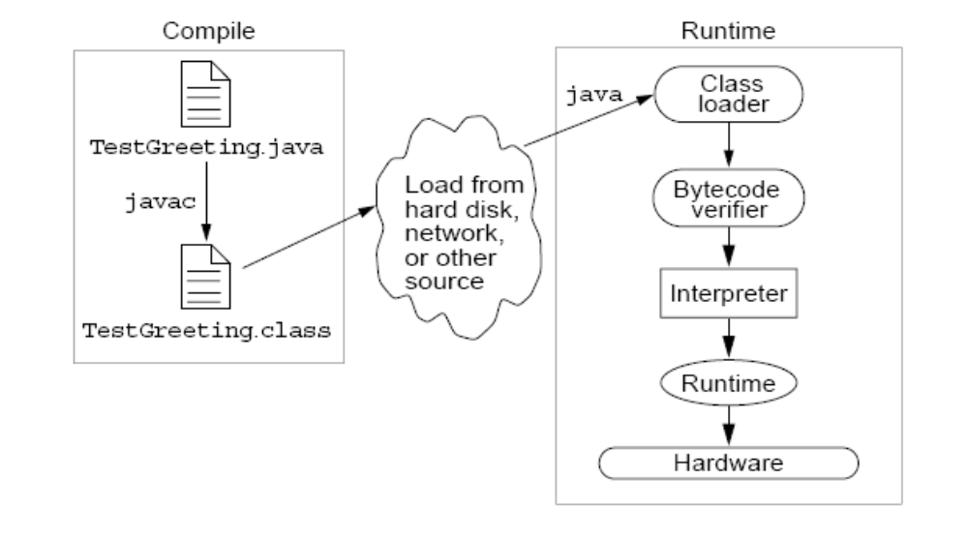
The Java Runtime Environment
The Java application environment performs as follows:

Slide 9
JVM™ Tasks
The JVM performs three main tasks:
  Loads code – Performed by the class loader.
  Verifies code – Performed by the bytecode verifier.
  Executes code – Performed by the runtime interpreter.

Slide 10
The Class Loader
Loads all classes necessary for the execution of a program.
Maintains classes of the local file system in separate namespaces.
Avoids execution of the program whose bytecode has been changed illegally.

Slide 11
The Bytecode Verifier
All class files imported across the network pass through the bytecode verifier, which ensures that:
  The code adheres to the JVM specification.
  The code does not violate system integrity.
  The code causes no operand stack overflows or underflows.
  The parameter types for all operational code are correct.
  No illegal data conversions (the conversion of integers to pointers) have occurred.

Slide 12
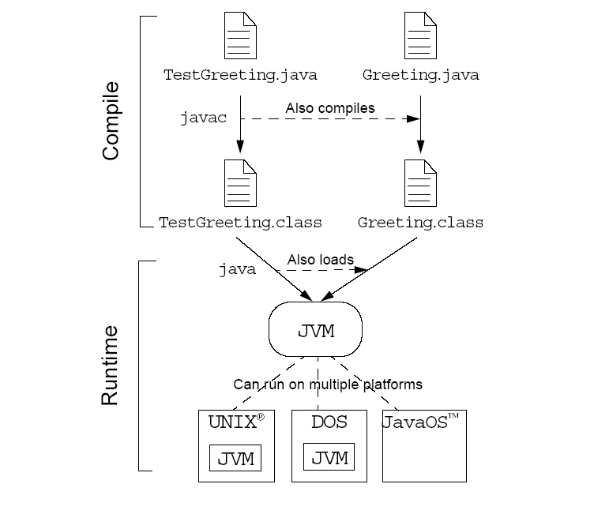
Java Technology Runtime Environment

Slide 13
A simple Java Application
Let see how to create a simple Java Application.

Slide 14
The Analysis and Design Phase
Analysis describes what the system needs to do:
  Modeling the real-world, including actors and activities, objects, and behaviors.
Design describes how the system does it:
  Modeling the relationships and interactions between objects and actors in the system.
Finding useful abstractions to help simplify the problem or solution.

Slide 15
Declaring Java Technology Classes
Basic syntax of a Java class:
  <modifier>* class <class_name>
  { <attribute_declaration>*
  <constructor_declaration>*
  <method_declaration>*
  }
Example:
  public class MyFirstClass
  { private int age;
  public void setAge(int value)
  { age = value;
  }
  }

Slide 16
Declaring Attributes
Basic syntax of an attribute:
  <modifier>* <type> <name> [ = <initial_value>];
Example:
  public class MyFirstClass
  {
  private int x;
  private float y = 10000.0F;
  private String name = “NIIT";
  }

Slide 17
Declaring Methods
Basic syntax of a method:
  <modifier>* <return_type> <name> ( <argument>* ){ <statement>* }
Example:
  public class Dog
  { private int weight;
  public int getWeight()
  { return weight;
  }
  public void setWeight(int newWeight)
  { if ( newWeight > 0 )
  { weight = newWeight;
  } } }

Slide 18
Accessing Object Members
To access object members, including attributes and methods, dot notation is used
  The dot notation is: <object>.<member>
  Examples:
    d.setWeight(42);
    d.weight = 42; // only permissible if weight is public

Slide 19
Class Representation Using UML
Class representation of MyDate class:
MyDate
-day : int -month : int -year : int
+getDay() +getMonth() +getYear() +setDay(int) : boolean +setMonth(int) : boolean +setYear(int) : boolean
Class name
Attributes
Methods

Slide 20
Abstraction
Abstraction means ignoring the non-essential details of an object and concentrating on its essential details.

Slide 21
Encapsulation
Encapsulation provides data representation flexibility by:
  Hiding the implementation details of a class.
  Forcing the user to use an interface to access data.
  Making the code more maintainable.

Slide 22
Declaring Constructors
A constructor is a set of instructions designed to initialize an instance.
Basic syntax of a constructor:
  [<modifier>] <class_name> ( <argument>* )
  { <statement>* }
Example:
  public class Dog
  { private int weight;
  public Dog()
  { weight = 42;
  }
  }

Slide 23
The Default Constructor
There is always at least one constructor in every class.
If the programmer does not supply any constructor, the default constructor is present automatically.
The characteristics of default constructor:
  The default constructor takes no arguments.
  The default constructor body is empty.
  The default constructor enables you to create object instances with new xyz() without having to write a constructor.

Slide 24
Source File Layout
Basic syntax of a Java source file:
  [<package_declaration>]
  <import_declaration>*
  <class_declaration>+
For example, the VehicleCapacityReport.java file can be written as:
  package shipping.reports;
  import shipping.domain.*;
  import java.util.List;
  import java.io.*;
  public class VehicleCapacityReport
  { private List vehicles;
  public void generateReport(Writer output)
  {...} }

Slide 25
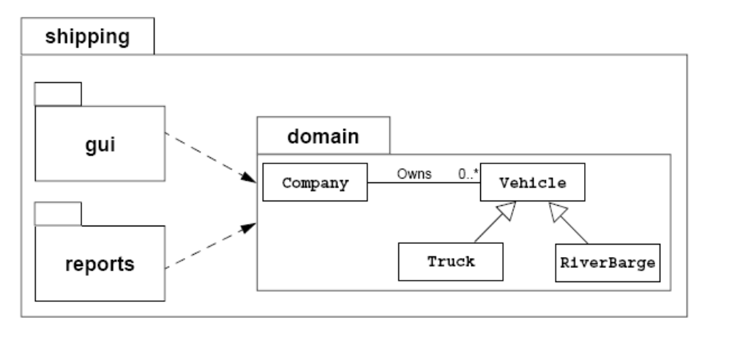
Software Packages
Packages help manage large software systems.
Packages can contain classes and sub-packages.

Slide 26
Software Packages (Contd.)
Basic syntax of the import statement:
  import
  <pkg_name>[.<sub_pkg_name>]*.<class_name>;
or
  import <pkg_name>[.<sub_pkg_name>]*.*;
Examples:
import java.util.List;
import java.io.*;
import shipping.gui.reportscreens.*;
The import statement does the following:
  Precedes all class declarations
  Tells the compiler where to find classes

Slide 27
Deployment
In order to deploy an application without manipulating the user’s CLASSPATH environment variable, create an executable Java Archive (JAR) File.
To deploy library code in a JAR file, copy the JAR file into the ext subdirectory of the lib directory in the main directory of the JRE.

Slide 28
Using the Java Technology API Documentation
The main sections of a class document include the following:
  The class hierarchy
  A description of the class and its general purpose
  A list of attributes
  A list of constructors
  A list of methods
  A detailed list of attributes with descriptions
  A detailed list of constructors with descriptions and formal parameter lists
  A detailed list of methods with descriptions and formal parameter lists

Slide 29
Summary
In this session, you learned that:
  The key features of Java technology include:
    A programming language
    A development environment
    An application environment
    A deployment environment
  JVM can be defined as an imaginary machine that is implemented by emulating it in software on a real machine.
  Java source files are compiled, get converted into a bytecode file. At runtime, the bytecodes are loaded, checked, and run in an interpreter.
  Garbage collector checks for and frees memory no longer needed, automatically.

Slide 30
Summary (Contd.)
  The three main tasks performed by the JVM include:
    Loads code
    Verifies code
    Executes code
  There are five primary workflows in a software development project: Requirement capture, Analysis, Design, Implementation, and Test.
  Abstraction means ignoring the non-essential details of an object and concentrating on its essential details.
  Encapsulation provides data representation flexibility by hiding the implementation details of a class.
  The Java technology class can be declared by using the declaration:
    <modifier> * class <class name>
  The declaration of a Java object attribute can be done as:
    <modifier> * <type> <name>

Slide 31
Summary (Contd.)
  The definition of methods can be done as:
    <modifier> * <return type> <name> (<argument> *)
  The dot operator enables you to access non-private attribute and method members of a class.
  A constructor is a set of instructions designed to initialize an instance of a class.
  The Java technology programming language provides the package statement as a way to group related classes.
  The import statement tells the compiler where to find the classes which are grouped in packages.
  The Java technology API consists of a set of HTML files. This documentation has a hierarchical layout, where the home page lists all the packages as hyperlinks.

